Slide 1



Interim Report of Group Project
Presentation: Yinqiao Li
Notes:
Good afternoon, everyone. My name is Yinqiao Li. I'm delighted to welcome you to our team's Mid-term project report.

Slide 2


Content
Project Introduction
Module Introduction
Technology Stacks
Challenges and Issues
Notes:
In the next few minutes, I'll walk you through the core components of our project, including a brief on what we've been working on, the different modules that make it up, the technology stack we've chosen to work with, and the challenges we've encountered along the way.
By the end of this presentation, I hope to provide you a clear picture of our project and a comprehensive understanding of the hard work we have been putting in.

Slide 3
Project Introduction
What is our Project?

Slide 4
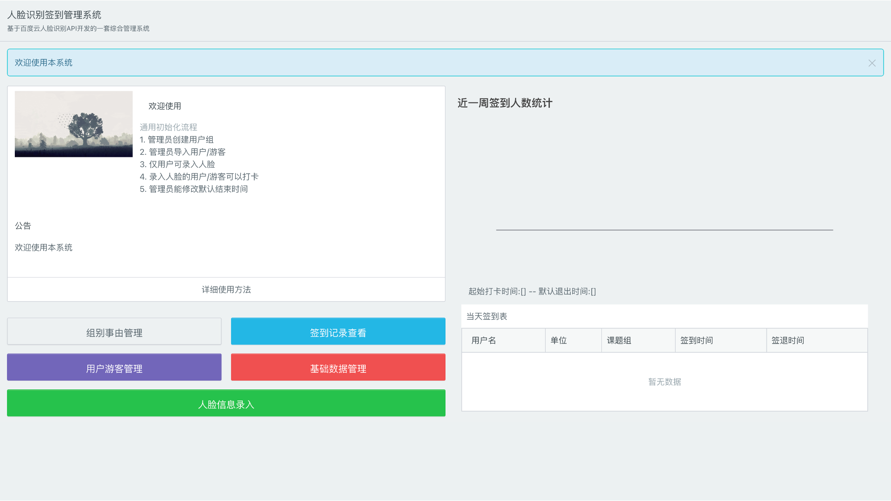
Notes:
Our Facial Recognition Attendance System Project is a comprehensive solution designed to help attendance management.

Slide 5

Notes:
So why we choose this program?
We chose this program for our CSIT883 project because it's right on the way for practical learning. It's a well-known project, not over-complicated, but it's spotting-on gripping with the course content. It's a straightforward choice that really does the job for understanding CSIT883.

Slide 6
Project Introduction
How do we develop our project?

Slide 7
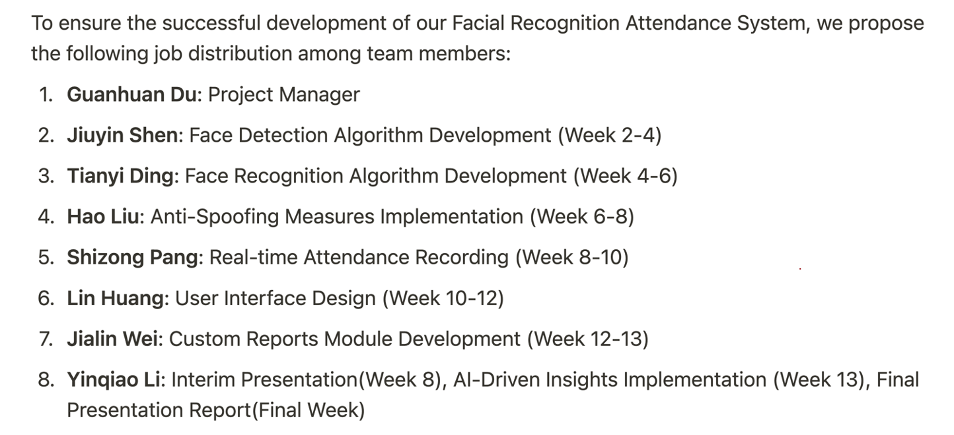
Project Introduction: Planned Individual Job Distribution
Notes:
We’ve divided the tasks among our team members, focusing on their strengths to maximize efficiency. Each team member has played a vital role, from the PM, Testing, Documentation specialists, to me, the PRE guy.

Slide 8
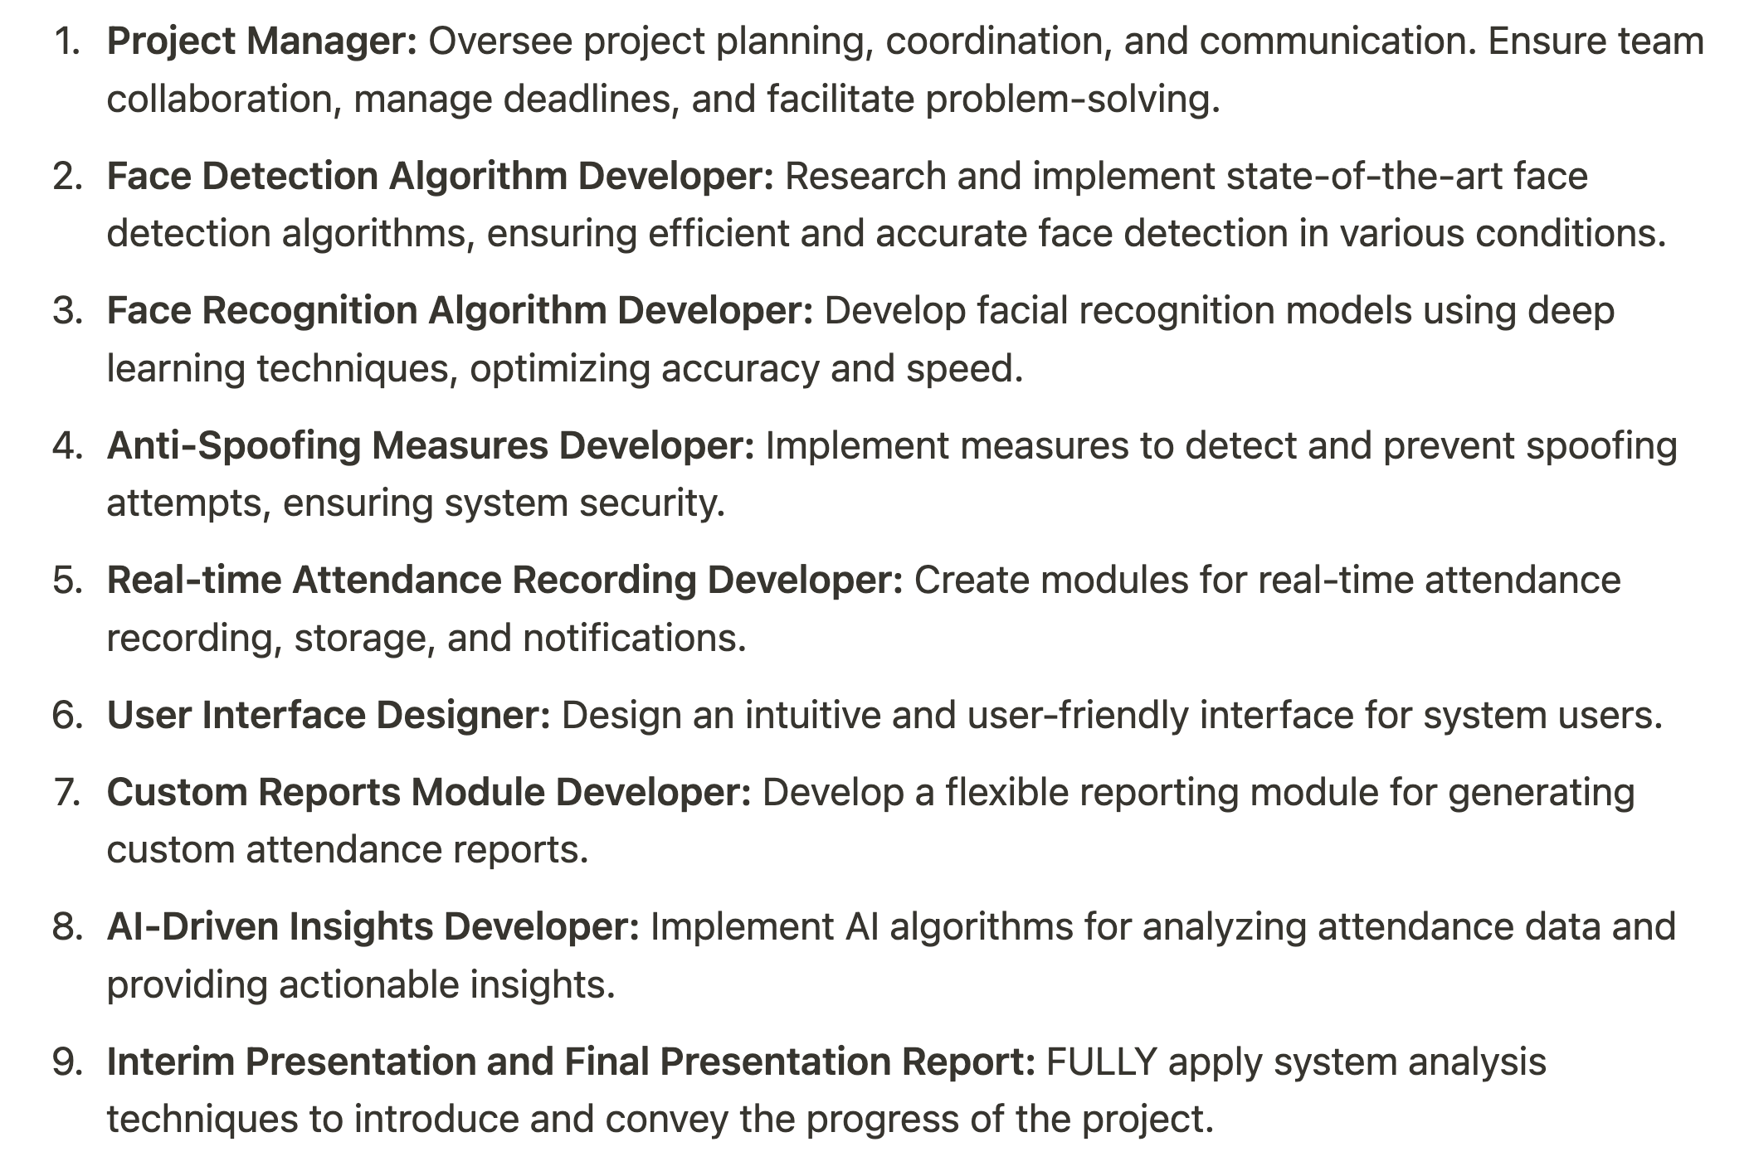
Project Introduction: Role of Each Team Member
Notes:
And here is the Role Specification of Each Team Member.

Slide 9
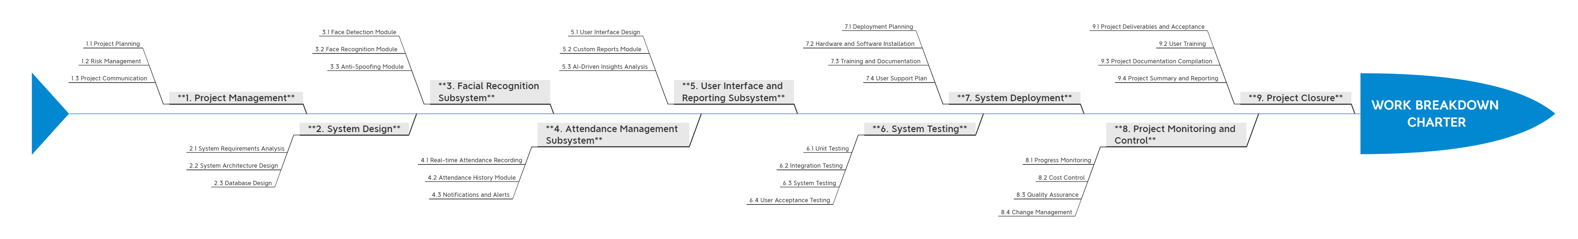
Project Introduction: WBS(Work Breakdown Structure)
Part I
Part II
Notes:
In the initial phase, we employed systems analysis and project management techniques to establish a clear structure for our project, focused on creating a WBS to organize tasks and ensure accountability.

Slide 10
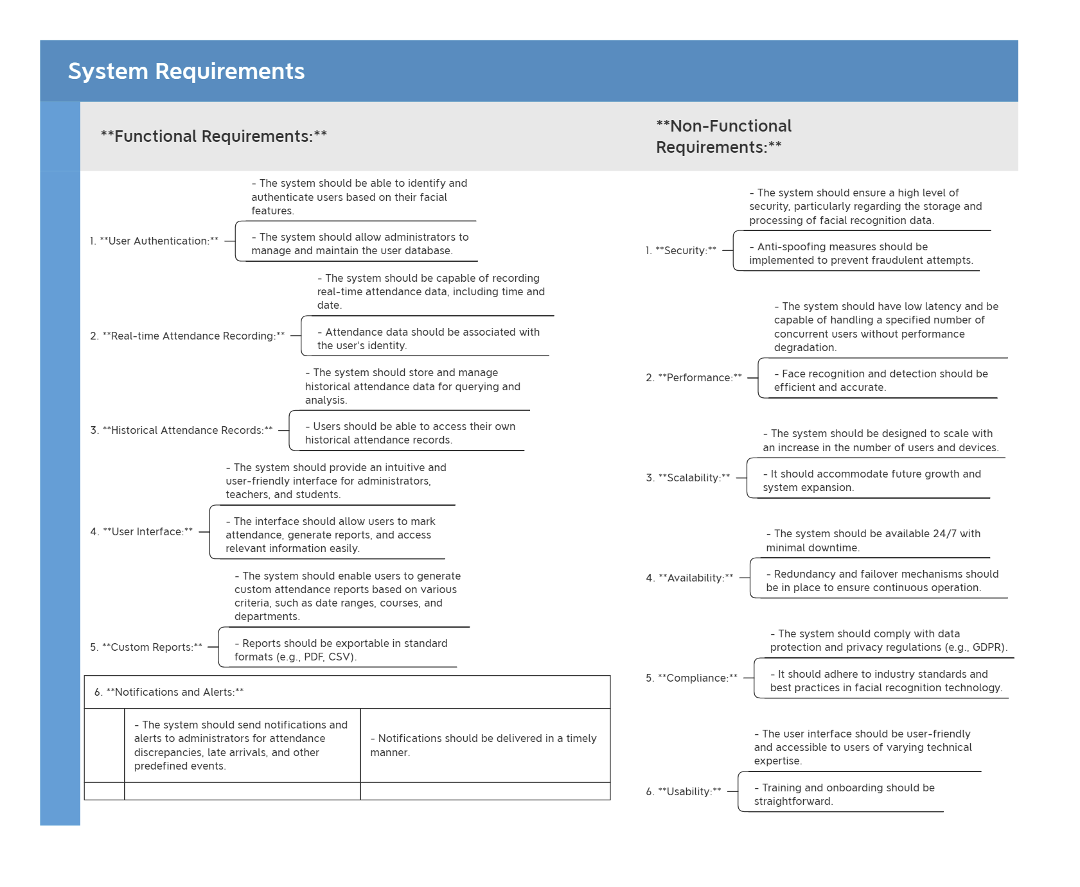
Project Introduction: System Requirements Analysis
Notes:
Our system requirements, focus on both functional aspects—like Real-time attendance recording and user authentication, and non-functional aspects such as security and performance, ensuring a robust and reliable system.

Slide 11
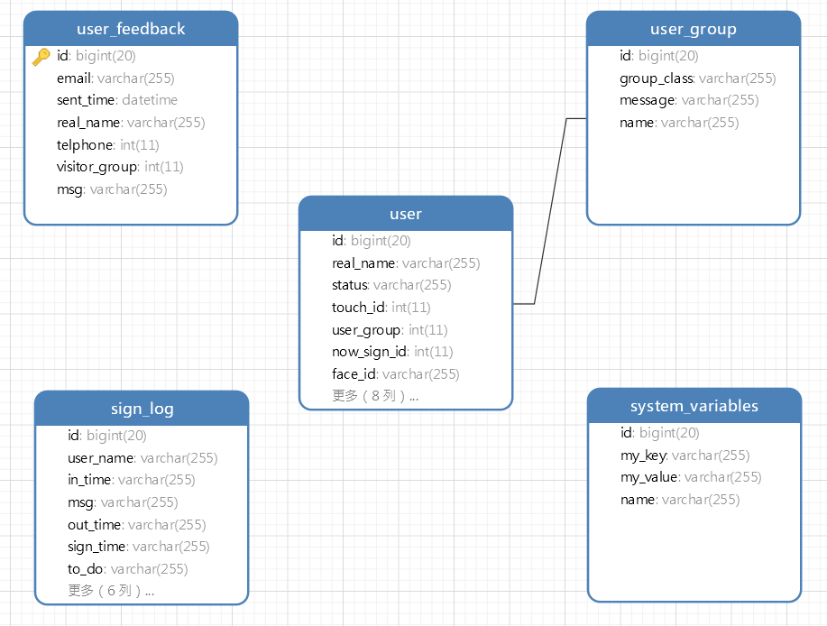
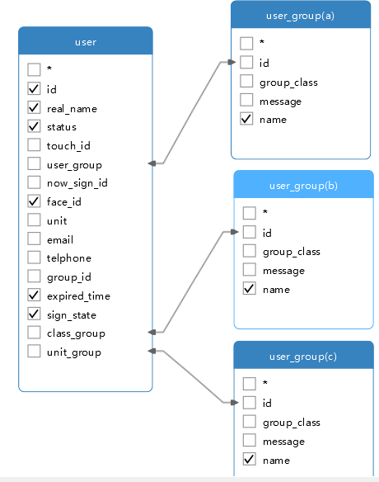
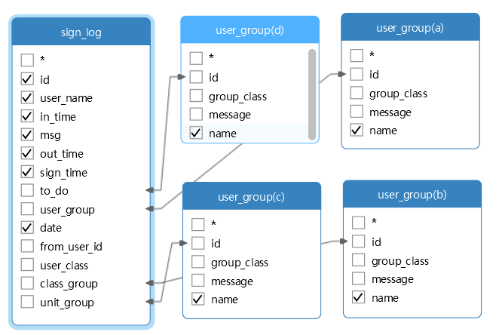
Project Introduction: Database Schema Overview
Notes:
Here‘s our database layout. It’s designed for optimizing data management and system functionality, showing tables like 'user', 'user_feedback', and 'sign_log', and how they interconnect to manage data

Slide 12
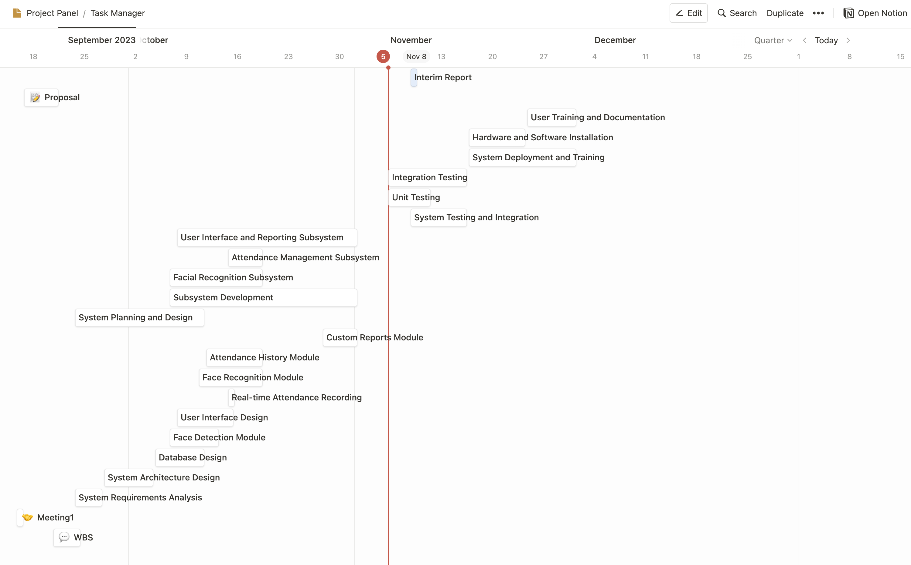
Notes:
We‘ve also established a Gannt chart for our development cycle, to ensure milestones are met. This Interim Report also plays a role of milestone, and this Gannt chart really helped us to keep the project moving on schedule.

Slide 13
Module Introduction
What modules does it have?

Slide 14


Module Introduction
Face Recognition & Detection
Attendance Recording
User Management
Notification
Fingerprint Recognition
Notes:
Our system features modules for Face Recognition, Attendance Recording, and User Management. NFC and Fingerprint Recognition are in development and pending evaluation for integration.

Slide 15
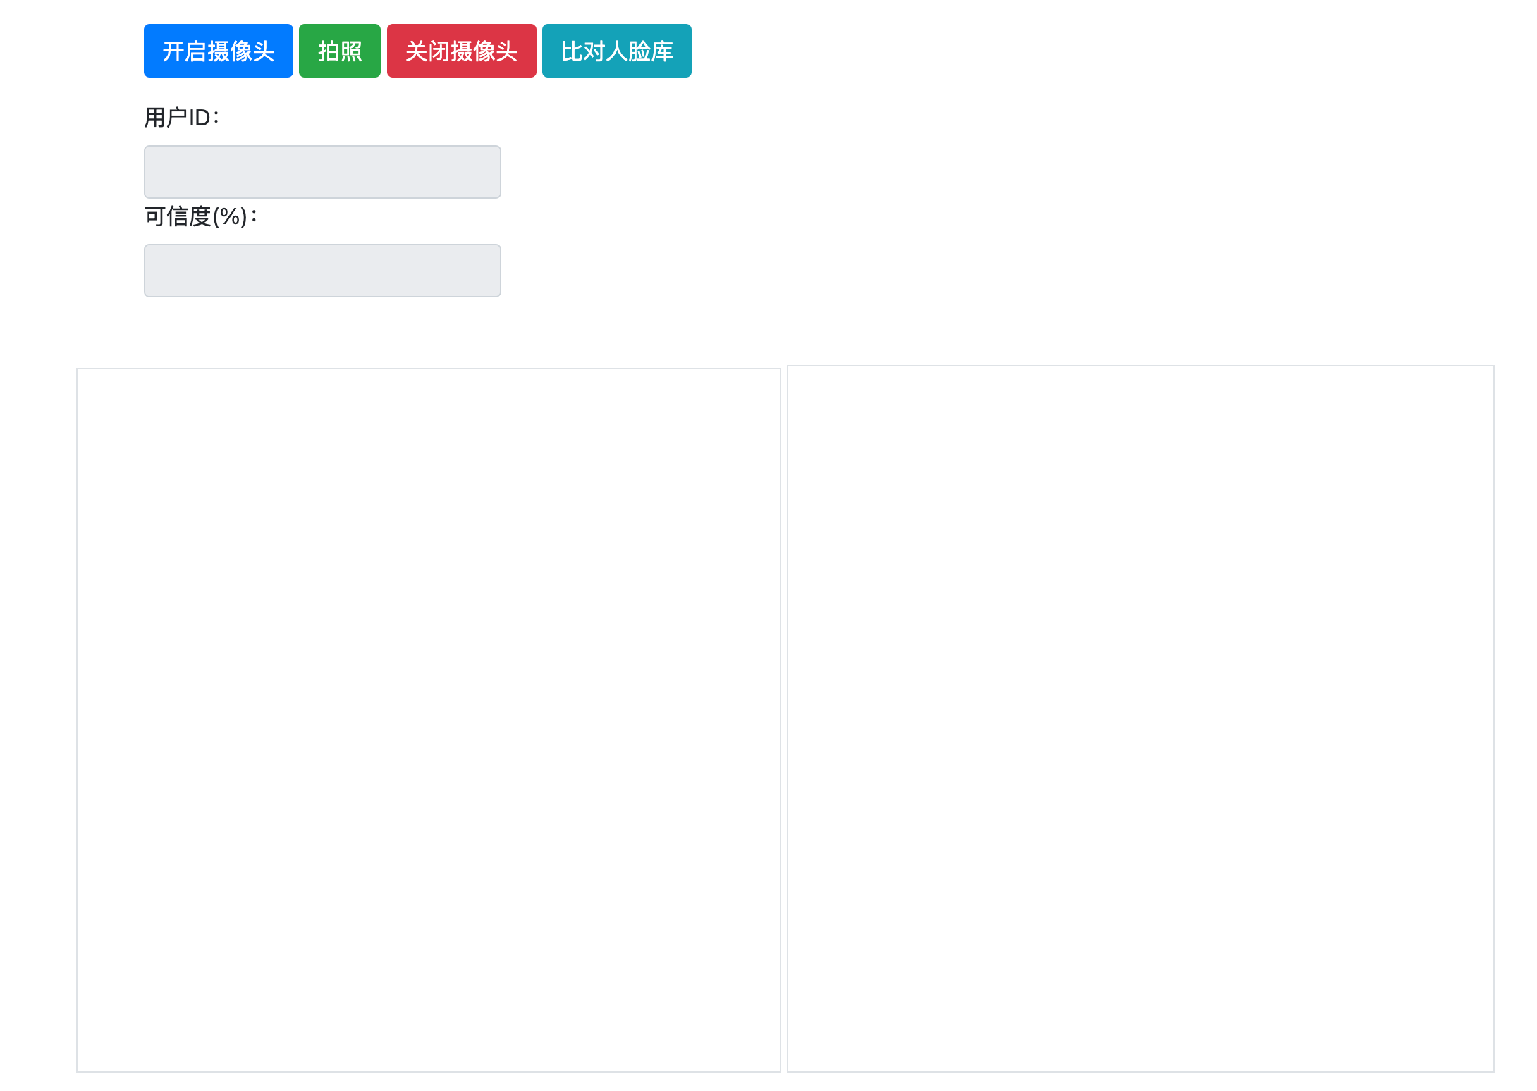
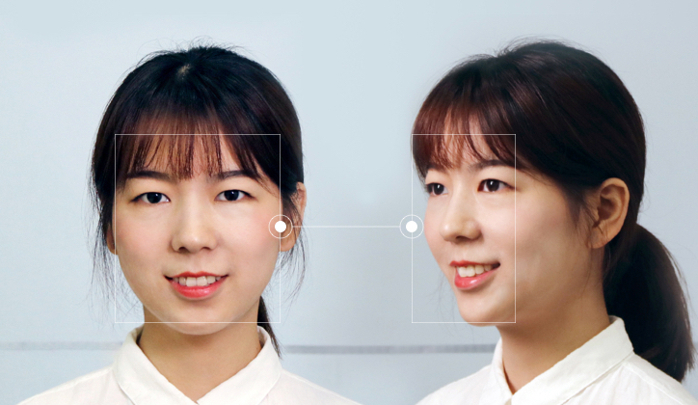
Module Introduction
Face Recognition
& Detection Module
BaiDu Identity Verification
Notes:
For the Face ID module, we leverage Baidu ID SDK to ensure accurate and reliable identification. This module employs algorithms to differentiate and verify individuals efficiently.

Slide 16
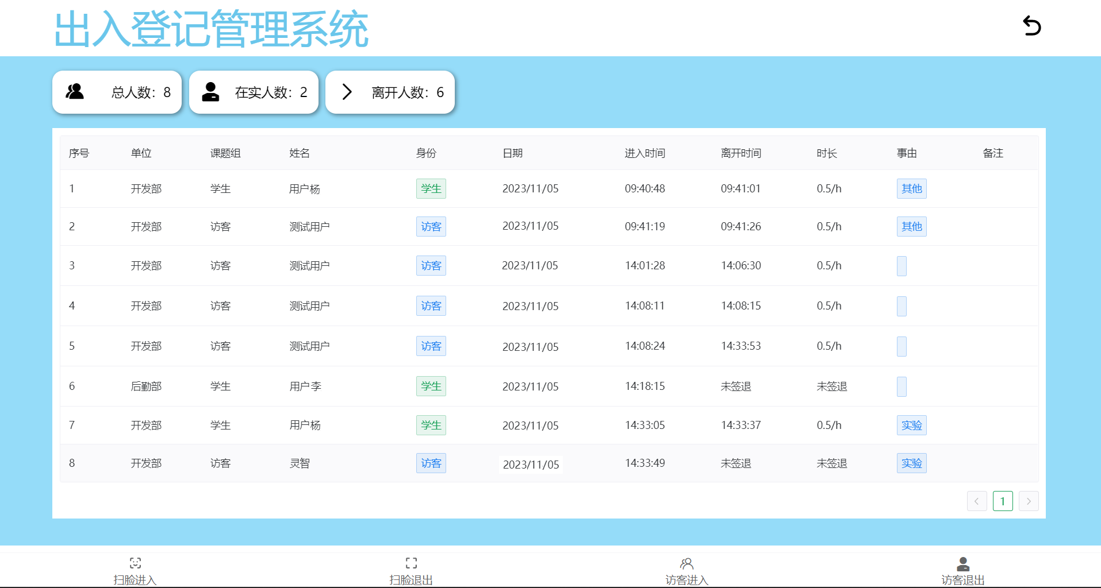
Module Introduction: Attendance Recording Module
Notes:
Turning on to the .,..Here we can track attendance status, with clear indicators for arrivals, departures, and exceptions.

Slide 17
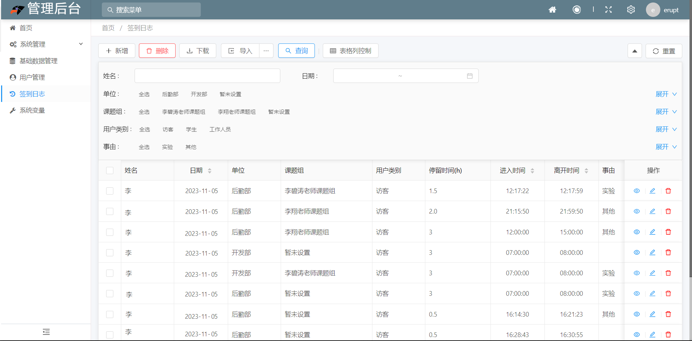
Module Introduction: User Management Module
Notes:
And here is our user management module page.

Slide 18
Technology Stacks
What technology stacks do we use?

Slide 19
Technology Stacks: Full Stack Technical Architecture
Frontend: Vue Framework
Backend: Java SpringBoot
Admin Management: Erupt Framework
Web Display: Baidu Amis & Bootstrap
Face Recognition: Baidu Cloud API & SDK
Notes:
Our project's tech stack includes Vue for a dynamic front end and Java Spring Boot for a solid backend. Erupt Framework manages admin tasks, while Baidu Amis and Bootstrap enhance web interfaces. For face recognition, we use Baidu Cloud API and SDK.

Slide 20
Progress and Issues
Challenges, Issues &
Complement

Slide 21
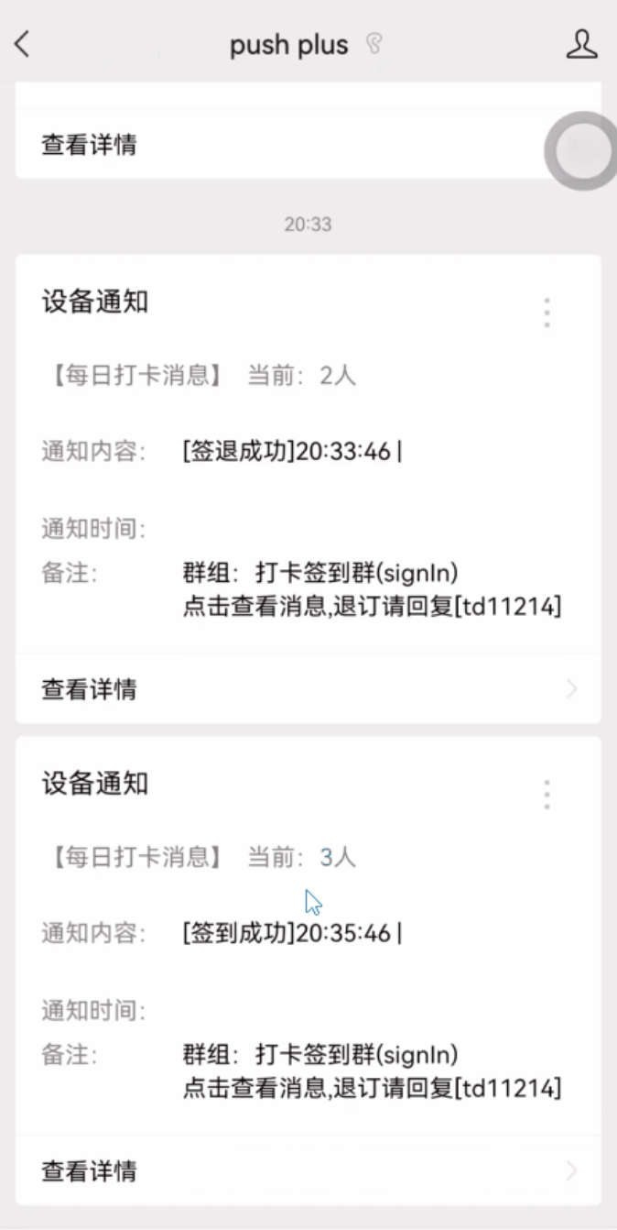
Progress and Issues
Fingerprint Recognition
Notification
Notes:
Our development efforts will focus on implementing notification pushing, and enabling message reception on WeChat. The necessity of the fingerprint recognition feature is under reassessment given the fact that we already have a facial recognition module. So the integration is pending determinations.

Slide 22
Thanks

